Slide 1
Romantic Literature
EH4278

Slide 2
Section 2 Breakdown
Week 6 – The Castle of Otranto (Horace Walpole)
Week 7 – The Castle of Otranto (Horace Walpole)
Week 8 – Wuthering Heights (Emily Brontë)
Week 9 – Wuthering Heights (Emily Brontë)
Week 10 – Class Test

Slide 3
Assessment of Section 2:
The remaining 40% of the total final grade based on the material covered will be allocated as follows:
An in-class test worth 40% of the total final grade will take place on Monday 27th March where students will be asked to answer one question in 45 minutes.

Slide 4
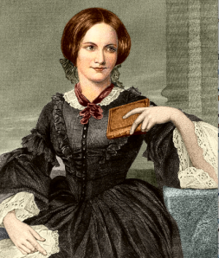
Emily Brontë (1818-1848)
Born in Yorkshire, England
Best known for writing Wuthering Heights, which was her only novel
Initially published it in 1847 under the male pen name ‘Ellis Bell’
She also wrote poetry and prose
Her sisters Charlotte & Anne were also famous writers who initially published their work under male pseudonyms
Many of her family, including Emily herself, died at a young age from tuberculosis
Although Wuthering Heights initially received mixed reviews, it developed a reputation as a literary masterpiece soon after her death
Interest in her life and work is still strong today
The Brontë Society run a museum that preserve and promote the family’s work
http://www.bronte.org.uk/about-us

Slide 5
Typical Elements of the Gothic Novel
A castle setting
An ancient prophesy and/or family curse
A dark atmosphere of mystery and suspense
Supernatural creatures and/or inexplicable happenings
Heightened emotions – hysterical reactions
Distressed heroines – often fleeing for their lives from…
Older, tyrannical men who wish to marry/murder them
Romantic hero – usually a disguised or unconventional suitor
Gothic terminology – words such as horror, terror, ominous, alarm, etc

Slide 6
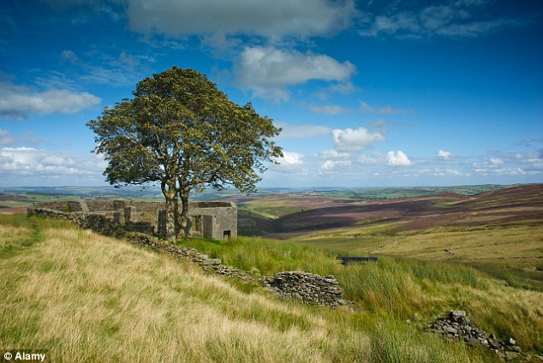
Top Withens farmhouse: Generally considered to have been the inspiration for Wuthering Heights farmhouse in the novel

Slide 7
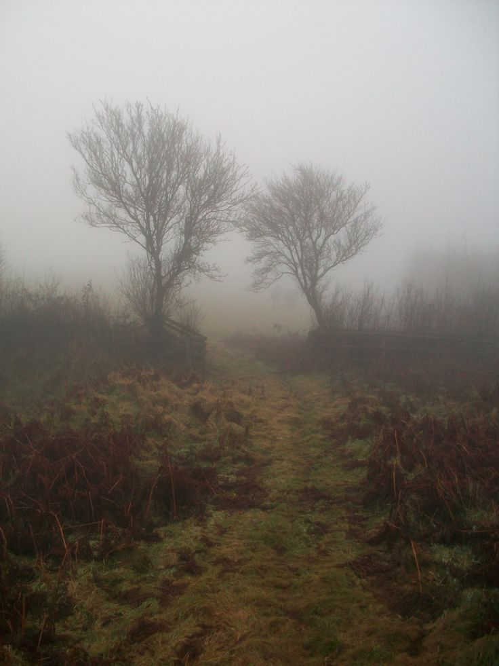
The English Moors
The Yorkshire moors are inspiration for its setting
‘Wuthering’ = the Yorkshire word for stormy weather
http://www.wuthering-heights.co.uk/locations/the-moors.php
*Note the Gothic elements in this image

Slide 8
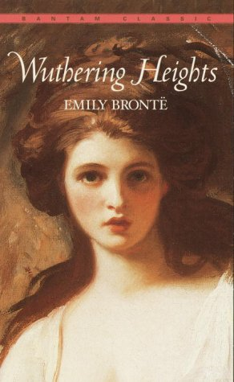
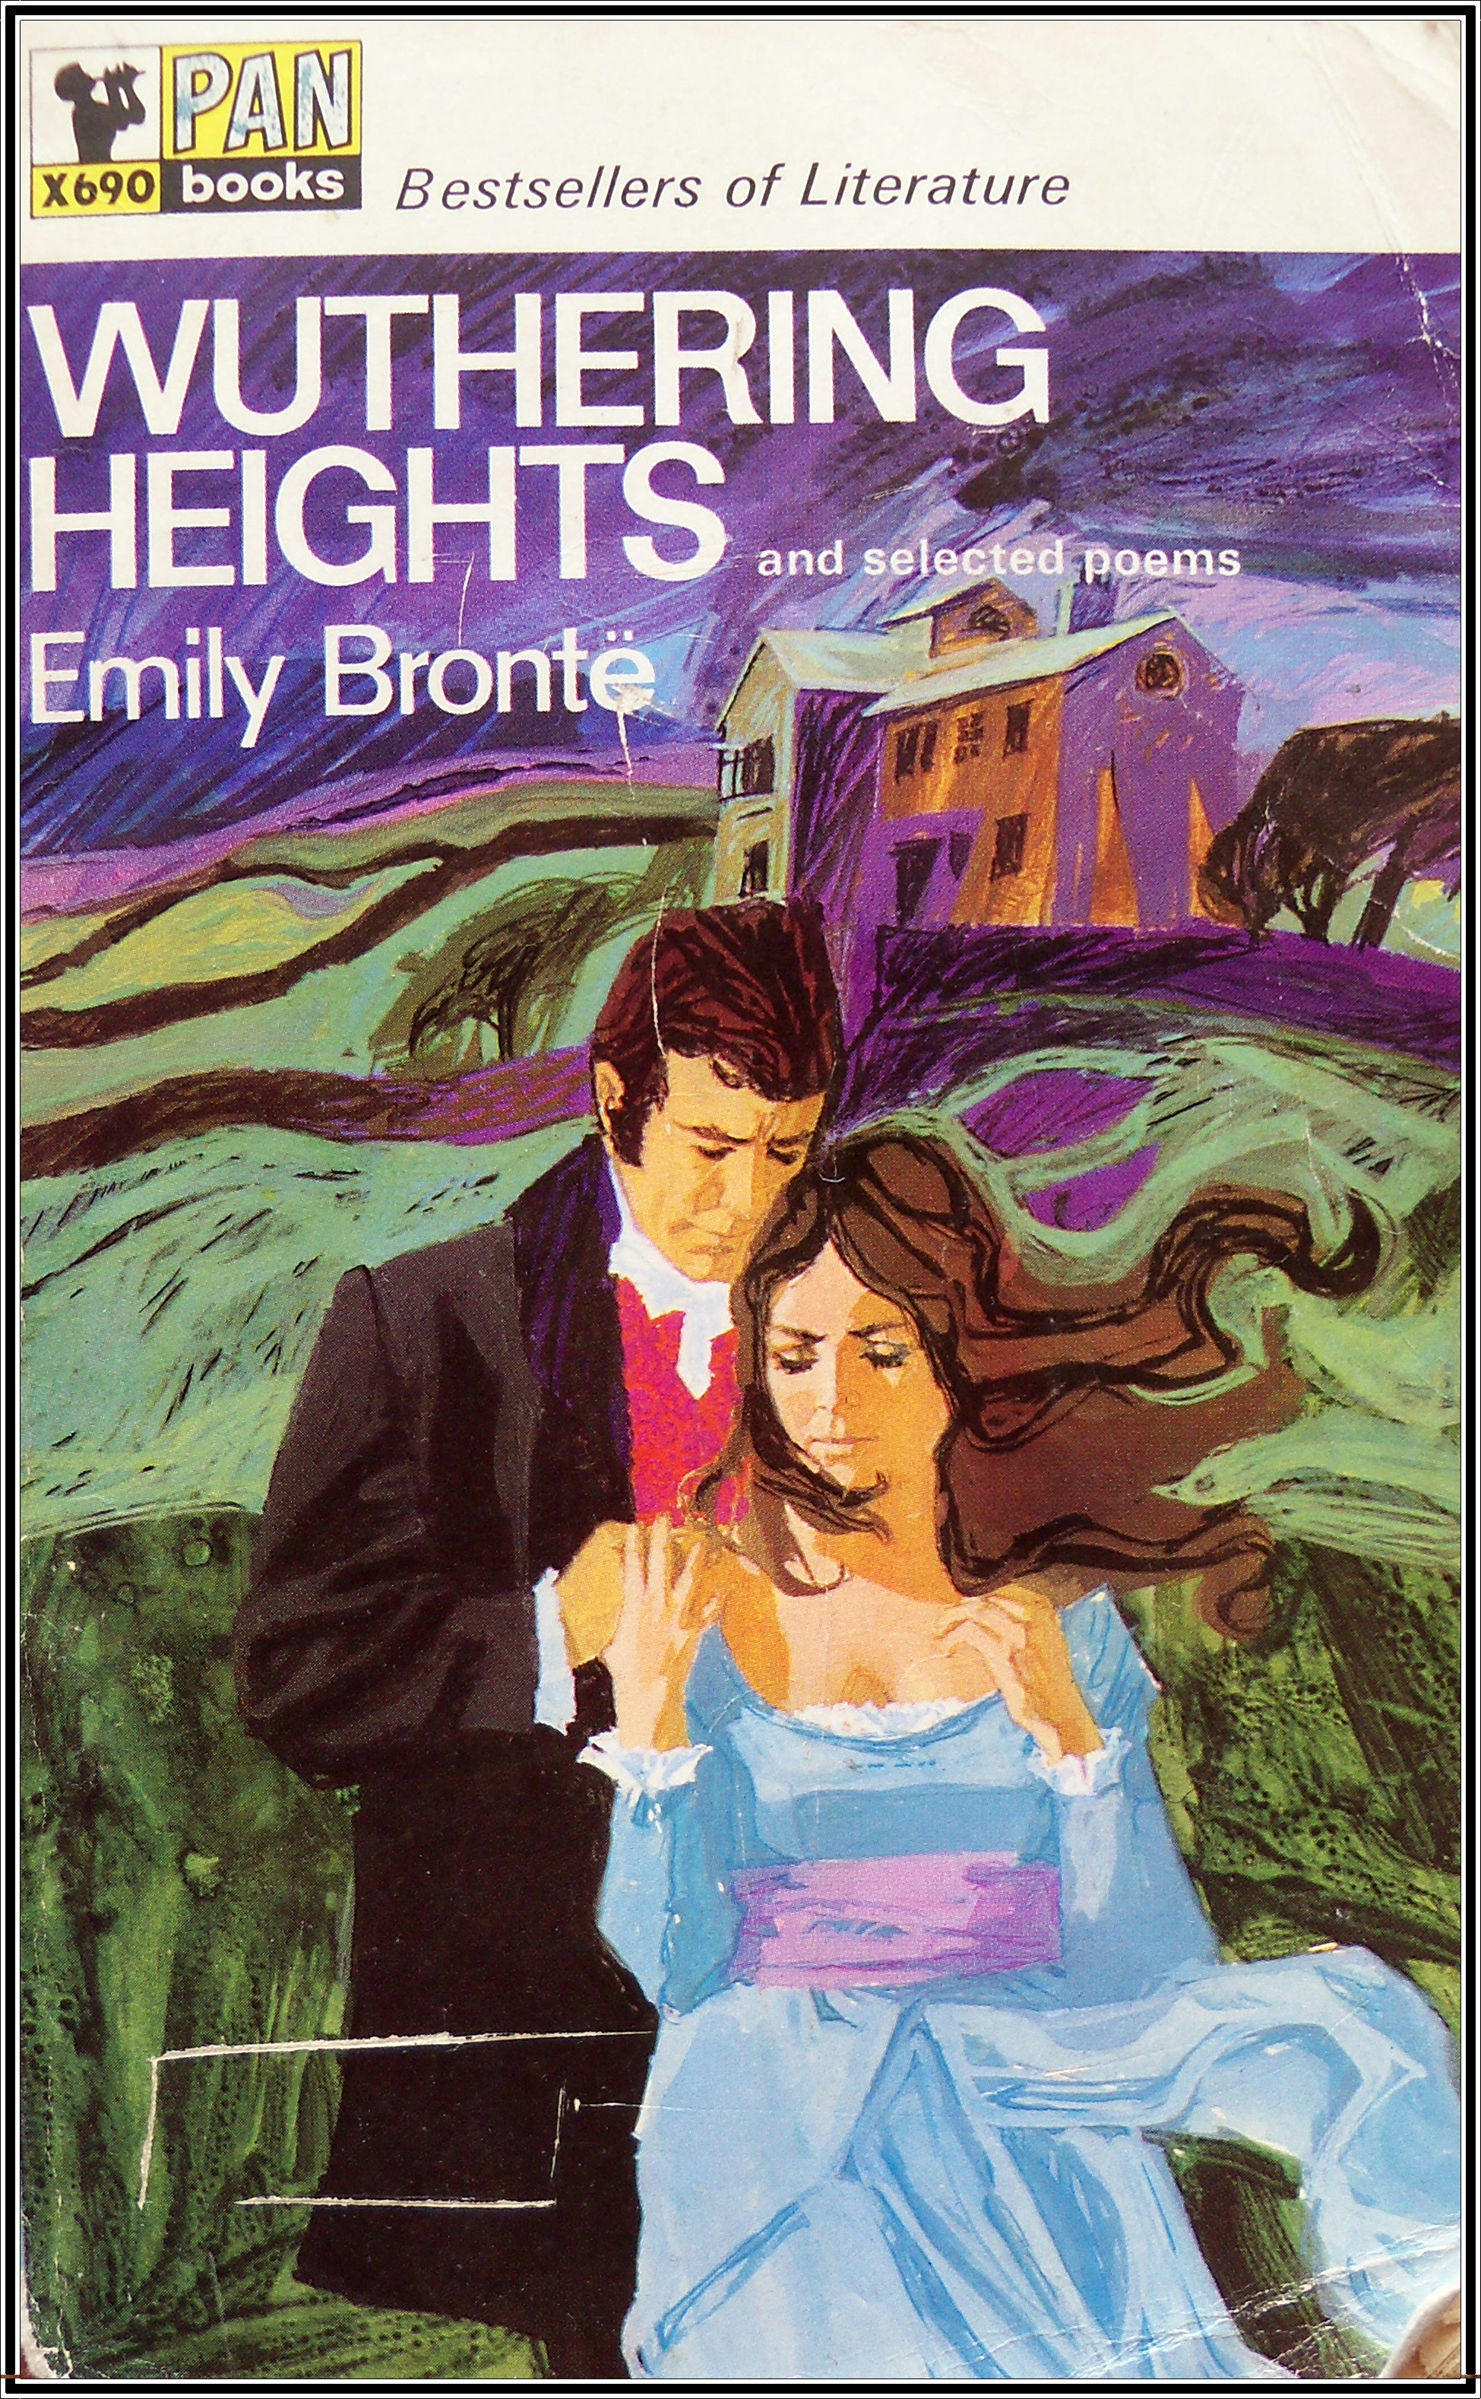
Wuthering Heights (1847)

Slide 9
Victorian Responses
‘A dark tale darkly told … we read what we dislike’ (Literary World)
‘[The] epitome of brutality, disavowed by man and devil … Nightmares and dreams, through which devils dance and wolves howl, make bad novels’ (North American Critic)
‘How a human being could have attempted such a book … without committing suicide … is a mystery. It is a compound of vulgar depravity and unnatural horrors’ (Graham’s Magazine)
‘The harshness, selfishness, and cruelty of Heathcliff are in our opinion inconsistent with the romantic love that he is stated to have felt for Catherine Earnshaw’ (The Examiner)
‘Nothing like it has ever been written before; it is hoped … for the sake of good manners, nothing will be hereafter … It will live a short and brilliant life and then die and be forgotten’ (Reviewer George Washington Peck)

Slide 10
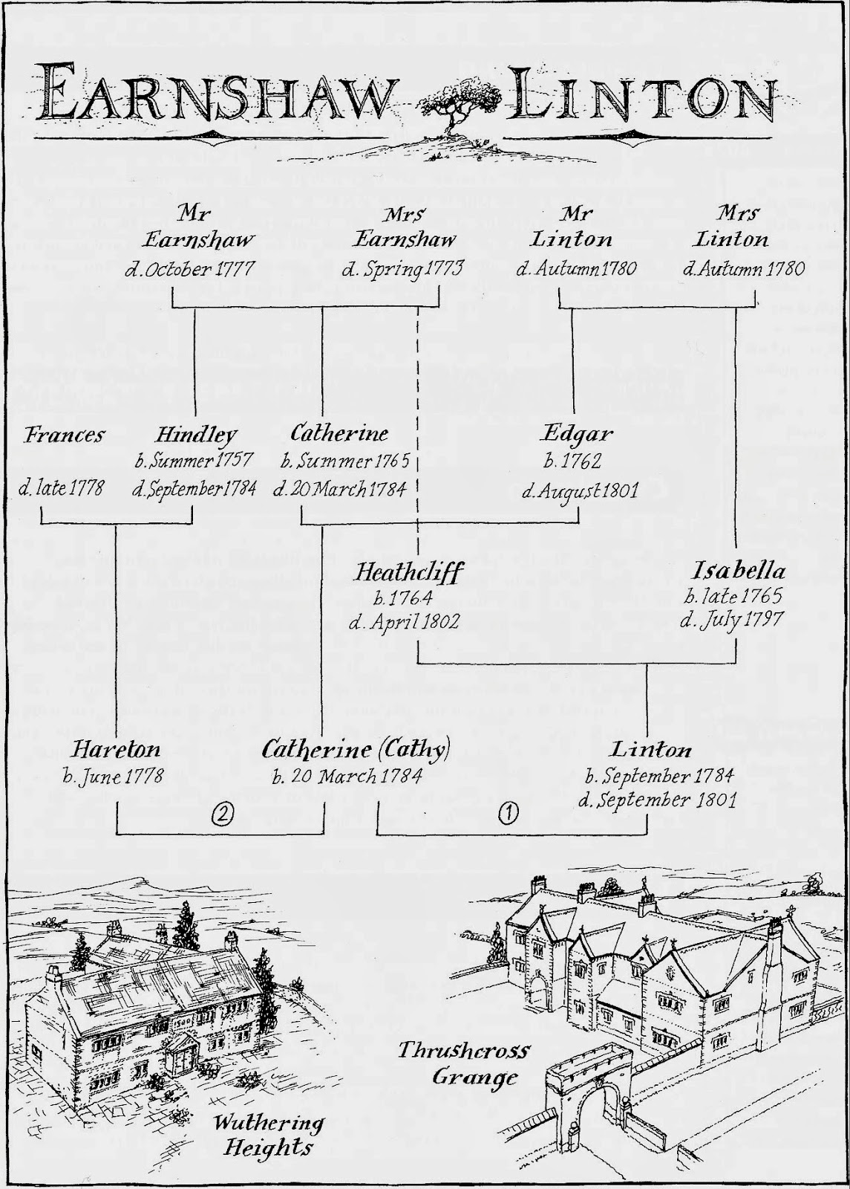
Genealogy in Wuthering Heights
Three generations of…
The Earnshaw family (+ Heathcliff)
The Linton family
Properties:
Wuthering Heights
Thrushcross Grange

Slide 11
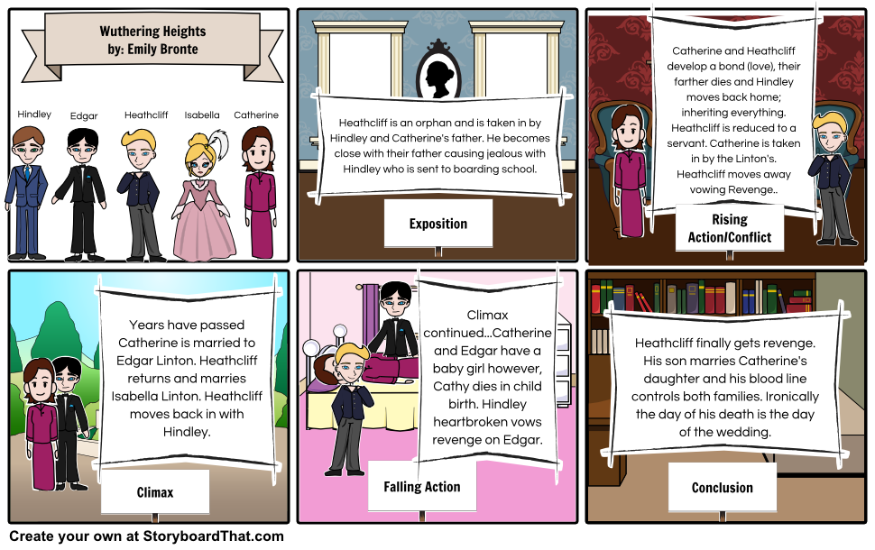
In a nutshell…

Slide 12
Gothic Elements in Wuthering Heights
Setting ( Two main sites of action & the moors surrounding them)
Atmosphere (Dark, dreary weather: pathetic fallacy)
Imprisonment
Concern re bloodline and land / wealth
Heightened emotions and erratic behaviour
Supernatural creatures (Catherine’s ghost)
Incest (Catherine & Heathcliff / Cathy & Linton / Hareton)
The Gothic heroine: Catherine
The Gothic hero: Heathcliff
Doubling of identity: Catherine & Cathy

Slide 13
Narration
A tale within a tale
Told through diary entries, story tales
Multiple (unreliable) narrators
Perspective and opinion
Movement between present and past (over a period of 50 years)
Flashback technique
Pathetic fallacy
Note the main characters’ dialogue (or lack of dialogue)
Sights and sounds in the narrative
Setting of the narrative (Yorkshire moors)

Slide 14
Themes
Confinement
Gender relations
Love and Revenge
Family and bloodlines
Society and class
Human suffering
Self and Other
Betrayal and conflict
The supernatural (and necrophilia)

Slide 15
Quotations to Note
Catherine: ‘Nelly, I am Heathcliff. He’s always, always in my mind … He’s more myself than I am.’
Catherine: ‘[I]f I cannot keep Heathcliff for my friend – if Edgar will be mean and jealous – I’ll try to break their hearts by breaking my own.’
Catherine: ‘I wish I were out of doors. I wish I were a girl again, half-savage and hardy, and free…’
Catherine: ‘I take [Heathcliff] with me – he’s in my soul.’
Nelly: ‘They were locked in an embrace from which I thought my mistress would never be released alive […], he gnashed at me, and foamed like a mad dog and gathered her to him with greedy jealousy.’
Heathcliff: ‘I shall pay Hindley back. I don’t care how long I wait … I hope he will not die before I do!’
Heathcliff: ‘I love my murderer.’
Heathcliff: ‘I have not broken your heart – you have broken it – and in breaking it, you have broken mine.’
Heathcliff: ‘I am surrounded with her image! The entire world is a dreadful memoranda that she did exist, and that I have lost her!’

Slide 16
Exam Prep
Worth: 40%
Exam time: 45 minutes
No text books allowed
Choice of three questions – you must answer one.
You can focus on one of the two novels.
Avoid too much plot summary – only include where relevant.
Include quotations from your chosen text for support.
Include secondary reading from academic sources only – i.e. chapters or articles (see PDFs on LAN if necessary).
PDFs of The Castle of Otranto & Wuthering Heights are also available on the LAN under MitchellD.
Answer the question!

